Slide 1

Predicting Customer Buying Behaviour

Slide 2
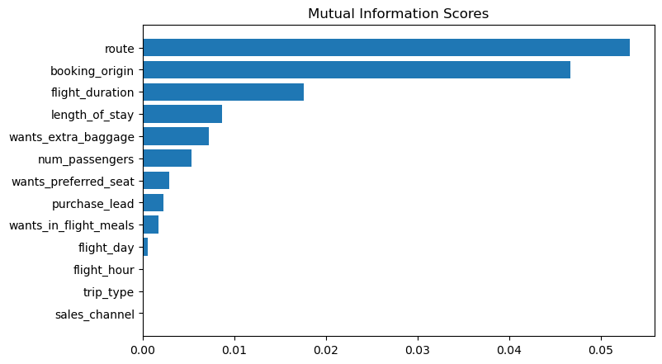
Predictive model to understand factors that influence buying behaviour
Random Forest classifier model is used to train on the data set
Accuracy: 85.09
AUC: 0.558
Top 5 features which affect customer buying behaviour:
route
booking_origin
flight_duration
length_of_stay
wants_extra_baggage
AUC score need to be increased
Word cloud of keywords in reviews

